Slide 1
MASS BALANCE OF REACTOR USING NUMERICAL DIFFERENTIATION
Group Members :
Spandan Das 12041480
Sarthak Ghule 12041300
Submitted to :
Dr. Vijay S. Duryodhan

Slide 2
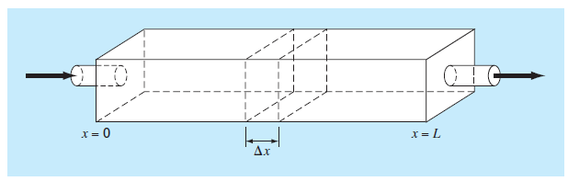
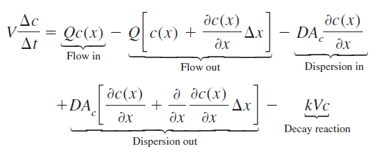
PROBLEM STATEMENT
Chemical engineers make extensive use of idealized reactors in their designwork.
Figure depicts an elongated
reactor with a single entry and exit
point. It is a distributed-parameter
system. If it is assumed that the
chemical is subjected to first-order decay1 and the tank is well-mixed
vertically and laterally, a mass balance can be performed on a finite segment of
length Δx, as in

Slide 3


where V = volume (m³), Q = flow rate (m³/h), c is concentration (moles/m³), D is a dispersion coefficient (m²/h), Ac is the tank’s cross-sectional area (m²), and k is the first order decay coefficient (h⁻¹).
From Fick’s First law :
The parameter D, therefore, reflects the magnitude of turbulent mixing. If Δx and Δt are allowed to approach zero, Then the initial equation becomes
Where U = Q/Ac is the velocity of the water flowing through the tank.
The problem is how do we solve the above PDE by using finite difference method ?

Slide 4



METHODOLOGY
Now this equation is a B² - 4AC = 0 parabolic natured partial differential equation (PDE). Since its parabolic it will marching in one direction, and i.e. forward so we need to apply forward finite divided difference :
We will also have to use Laplace's equation by a centered divided difference :

Slide 5

where

Slide 6





Boundary condition:
Prior to t = 0, the tank is filled with water that is devoid of the chemical and the chemical is injected into the reactor’s inflow at a constant level of c_{in}.
The second condition specifies that the chemical leaves the reactor purely as a function of flow through the outlet pipe. That is, it is assumed that dispersion in the reactor does not affect the exit rate.

Slide 7
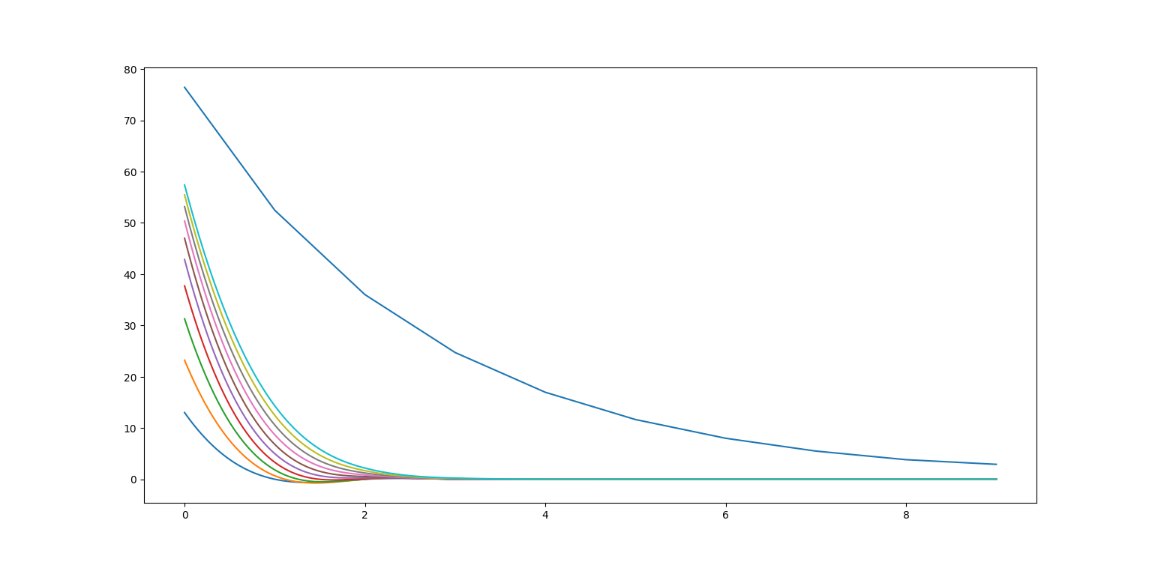
RESULTS AND DISCUSSION
numerical methods can be used to generate time variable solutions where the concentration in the tank is 0 at time zero.
As expected, the immediate impact is near the inlet.
With time, the solution eventually approaches the steady-state level.

Slide 8
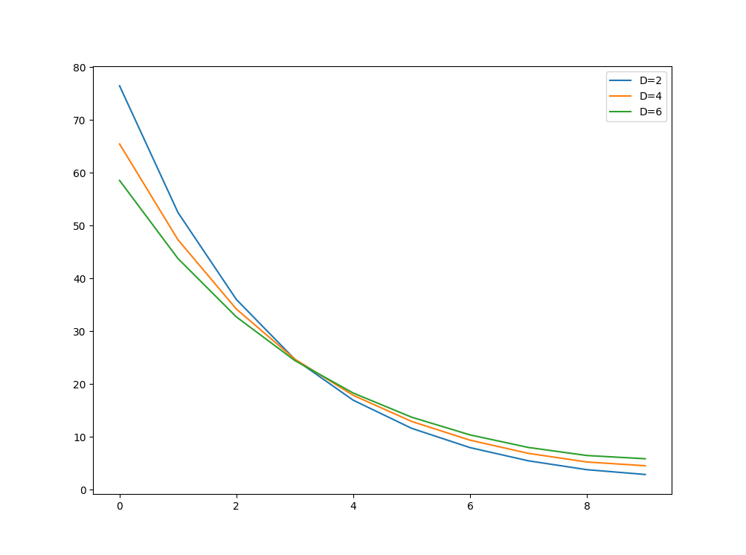
As expected, the concentration decreases due to the decay reaction as the chemical flows through the tank.
In addition to the above computation, increasing the turbulent mixing tends to flatten the curve.
In contrast, if dispersion is decreased, the curve would become steeper as mixing became less important relative to advection and decay

Slide 9

LIMITATIONS
Although satisfaction of :
(ƛ ≤ 1/2)will alleviate the instabilities
to a higher extent it also places
a strong limitation on the explicit method.
Let Δx be halved to improve the approximation of the spatial second derivative. As per the above equation, the time step must be quartered to maintain convergence and stability.
The computation for each of these time steps will take twice as long because halving Δx doubles the total number of nodes for which equations must be written.
Consequently, for the one-dimensional case, halving Δx results in an eightfold increase in the number of calculations. Thus, the computational burden may be large to attain acceptable accuracy.

Slide 10

FUTURE SCOPE OF IMPROVEMENT
Implicit methods overcome both these difficulties at the expense of somewhat more complicated algorithms.
The spatial derivative is approximated at an advanced time level (l + 1).The second derivative would be approximated by which is second-order accurate.
When this relationship is
substituted into the
original PDE, the resulting difference equation contains several unknowns.

Slide 11
In implicit method we have to change the time step ‘l’ in right hand side to ‘l + 1’ in the equation described in the methodology or if we are solving from the beginning then we can use the relation mentioned in previous slide at the beginning of our solving procedure.
The equation will look something like :
Now we need to start the iteration by putting the values of time steps with initial known to us and keep on iterating till our last iteration.
The implicit formulations result in a set of linear algebraic equations with the same number of unknowns. Thus, the method reduces to the solution of a set of simultaneous equations at each point in time.
Further a tridiagonal matrix will be formed and can be solved to get the desired solutions.

Slide 12
THANK YOU !

